Slide 1

TITANIC

Slide 2
Introduction
The entire Royal Mail Ship Titanic (RMS) Around 1,500 passengers and crew members perished when the British luxury passenger liner Titanic sank on April 14–15, 1912, while on her first journey from Southampton, England, to New York City.
The keel was laid for the Titanic on March 31, 1909. The ships was constructed in a unique gantry designed to handle the unheard-of scale. Thomas Andrews of Harland & Wolff designed the sister ships(Olympic and Titanic) in substantial part. The Titanic had enormous first-class dining saloon, four elevators, and a swimming pool in addition to elaborate decorations. Although basic, its third-class cabins were still praised for their relative comfort. Its second-class accommodations were equivalent to first-class amenities on rival ships.
The Titanic had 16 compartments with doors that could be closed from the bridge, allowing water to be confined if the hull was damaged. The bulkheads were not capped at the top, despite being thought to be watertight. Four of the compartments, according to the ship's designers, could be submerged without harming the liner's buoyancy. Many people believed that the Titanic couldn't sink because of the system.
The Titanic's hull and primary superstructure were finished, and it was launched on May 31, 1911. Then came the fitting-out stage, during which the ship's machinery was loaded and interior construction got under way. After the Olympic's inaugural trip in June 1911, the Titanic's design underwent minor modifications. The Titanic underwent its sea trials at the beginning of April 1912, and was subsequently deemed seaworthy.

Slide 3
The Trip
The Titanic embarked on its maiden trip from Southampton, England, to New York City on April 10, 1912. The ship was appropriately dubbed the "Millionaire's Special," and Edward J. Smith, also known as the "Millionaire's Captain," was in charge.
The Titanic started to approach a region known to have icebergs on the evening of April 14. In order to head further south, Smith slightly changed the ship's course. He nevertheless kept the ship moving at a speed of about 22 knots. The Mesaba transmitted a warning about an ice field at around 9:40 PM. The Titanic's bridge was never informed of the message. The Californian, a nearby Leyland liner, sent news at 10:55 PM that it had halted after becoming encircled by ice. The Californian was reprimanded by Phillips for interrupting him while he was handling passenger messages.
An iceberg was spotted at about 11:40 PM, about 400 nautical miles (740 km) south of Newfoundland, Canada, and the bridge was alerted. First Officer William Murdoch gave the orders to reverse the engines and turn the ship "hard-a-starboard," which, according to the system of orders in use at the time, would turn the ship to port (left). Though it was too close to avoid a crash, the Titanic started to spin. The iceberg was scraped by the ship's port side. There were ruptures in at least five of its ostensibly watertight compartments at the bow. Andrews evaluated the damage and concluded that when the ship's front compartments filled with water, her bow would sink further into the water, allowing water from the ruptured compartments to spill over into each subsequent compartment, sealing the ship’s faith.

Slide 4
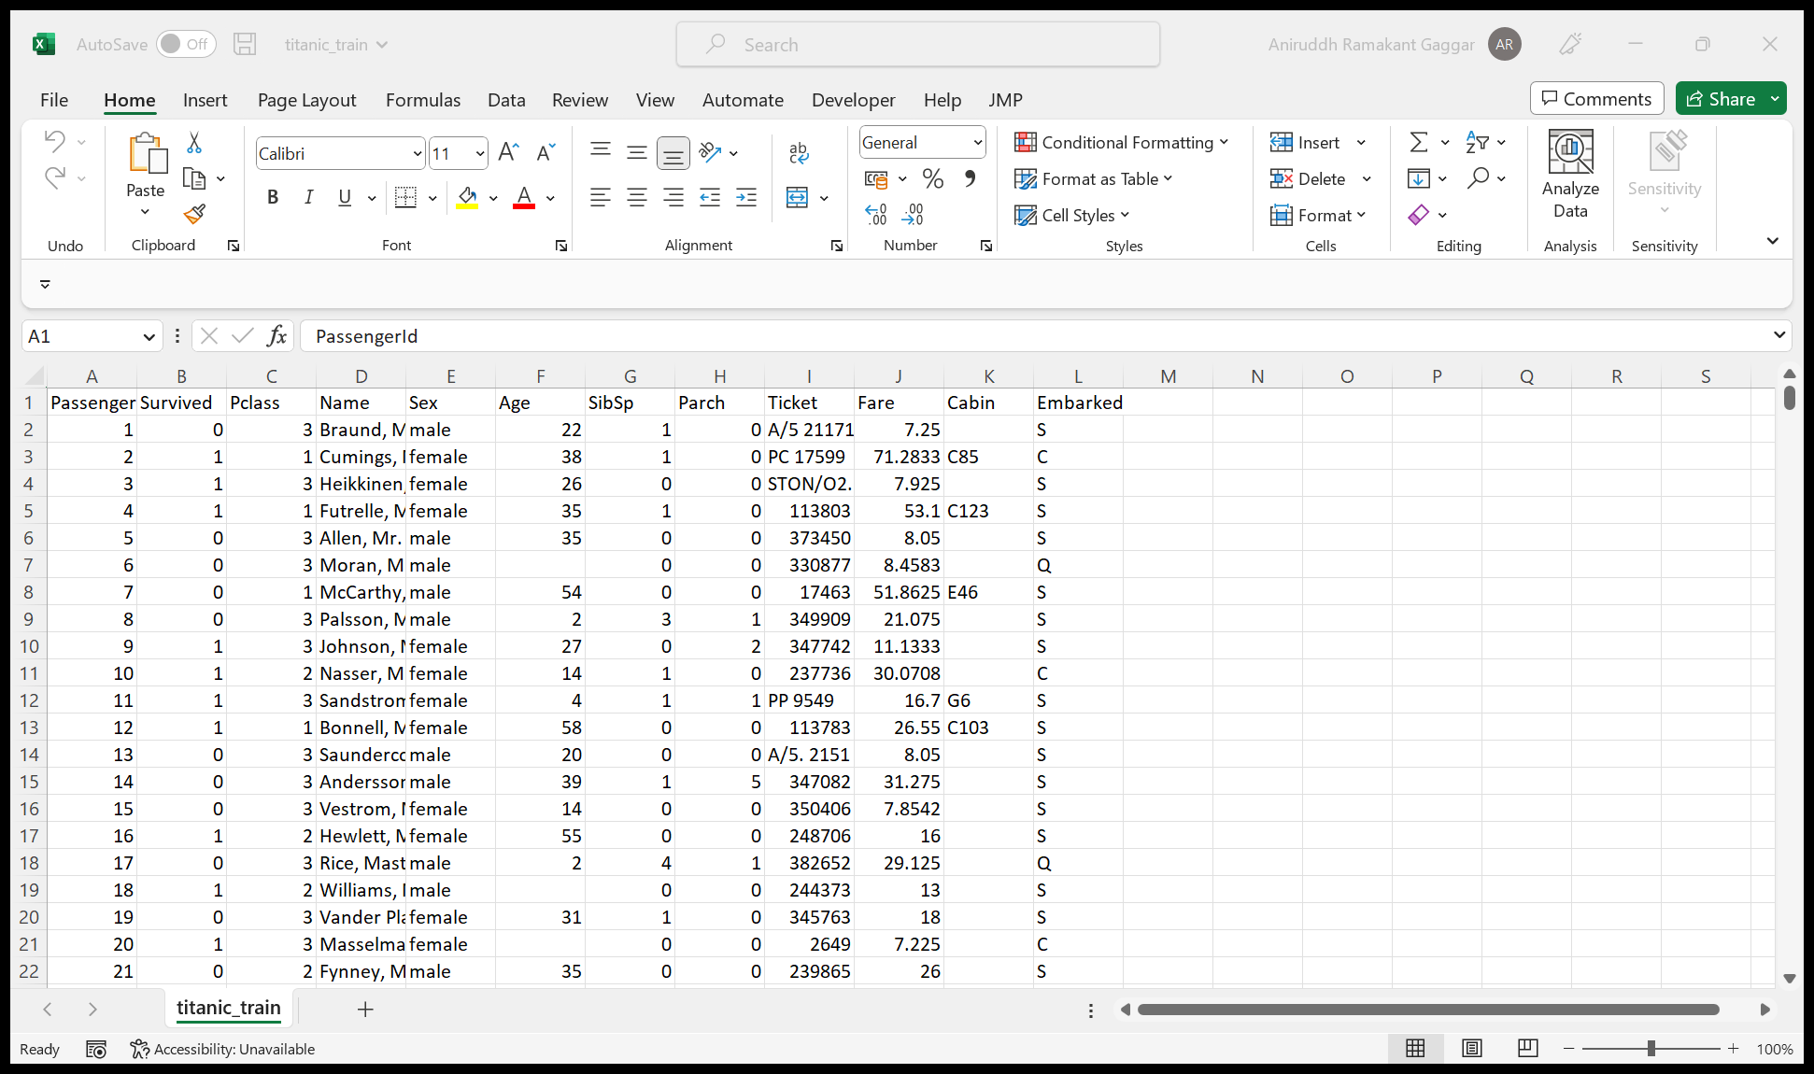
Snapshot of the dataset

Slide 5
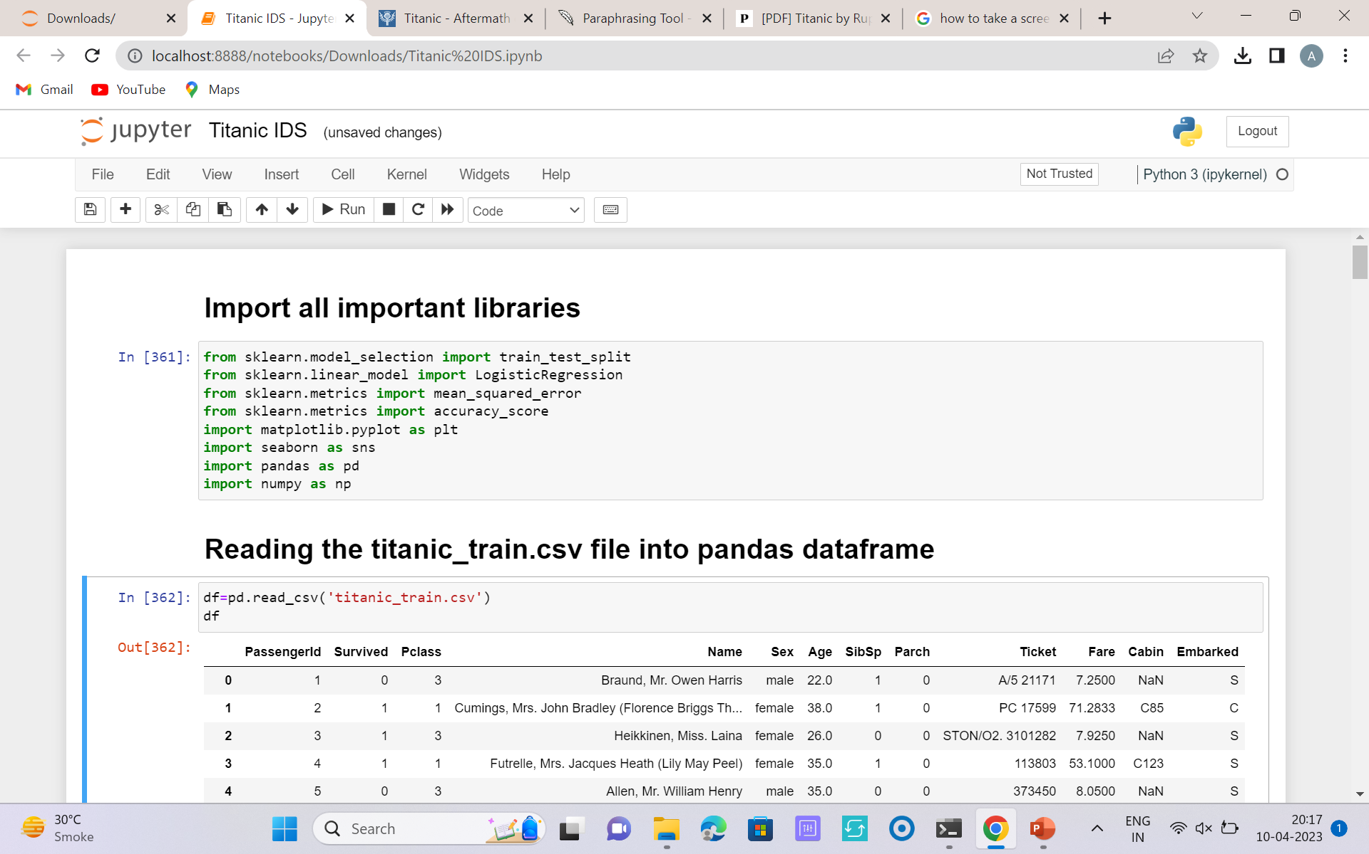
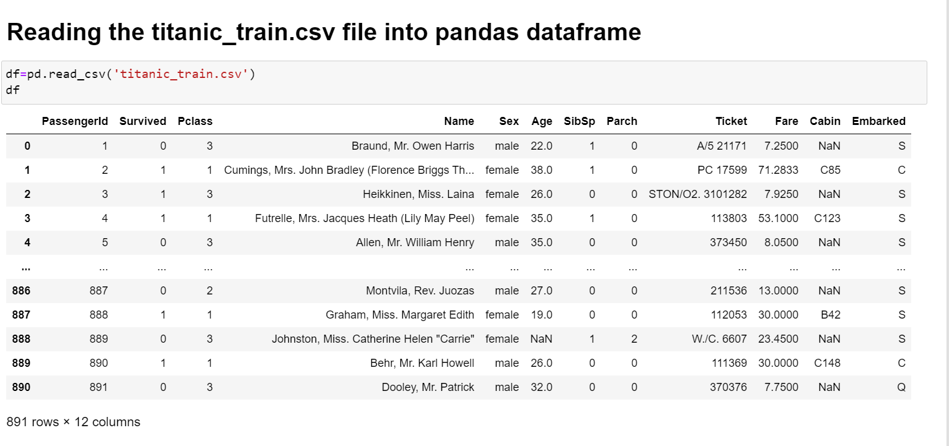
Importing the libraries and reading the data

Slide 6
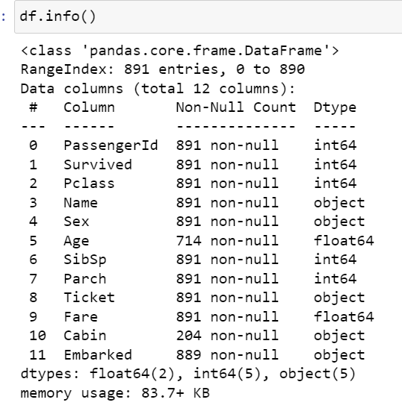
Some Information regarding the data

Slide 7
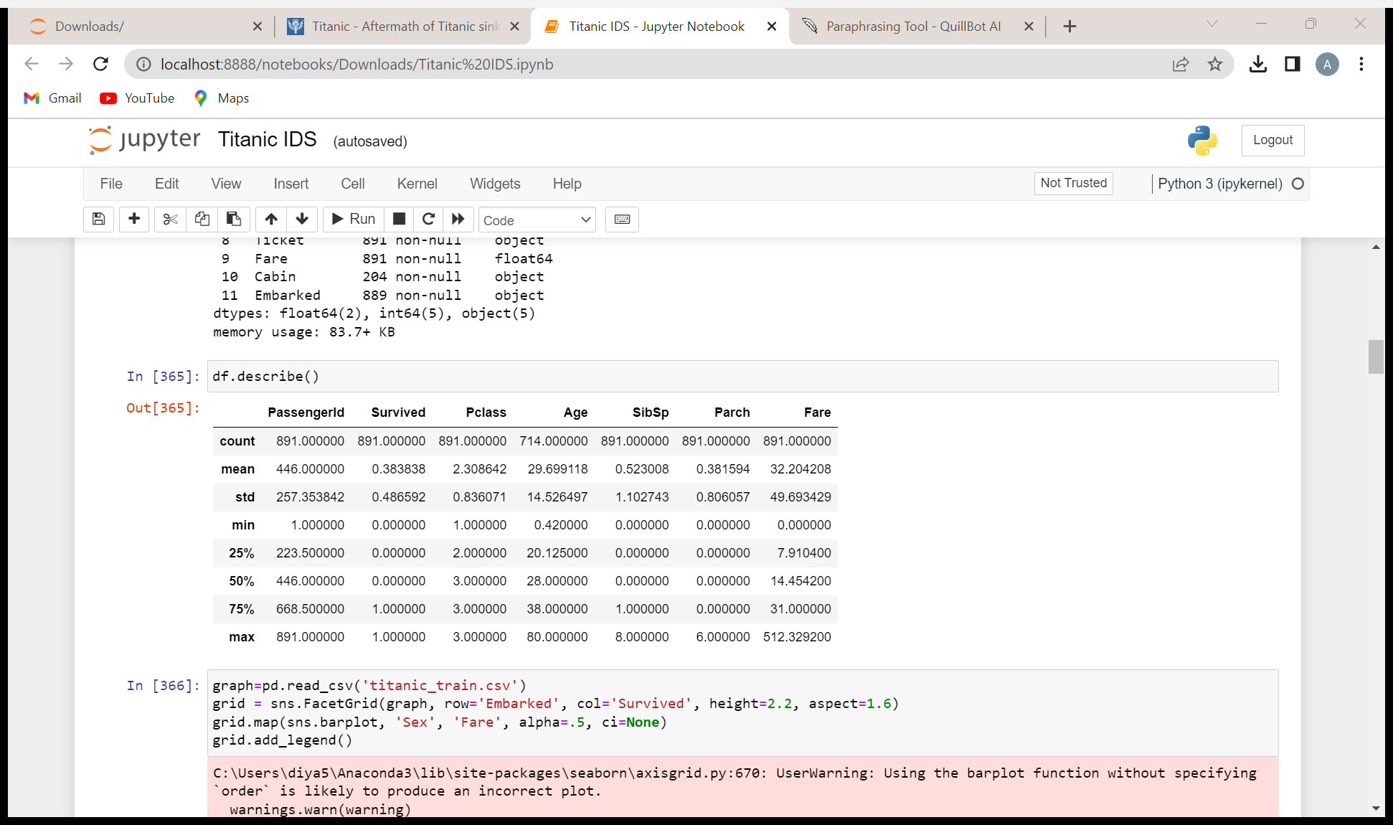
Describing the Data

Slide 8
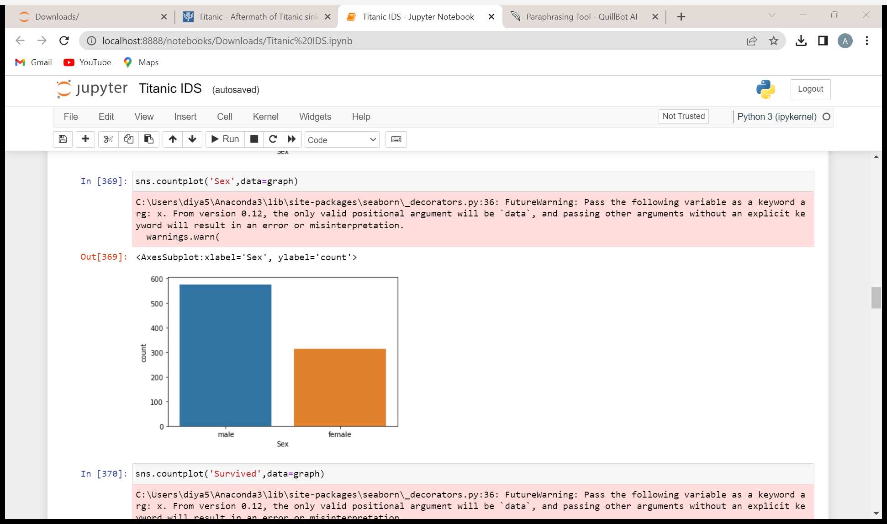
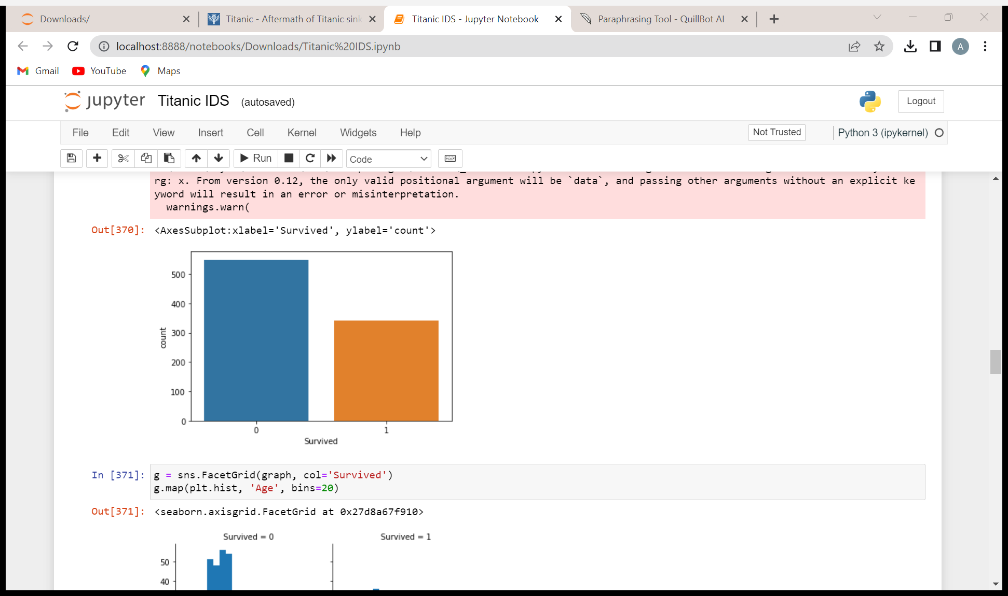
Exploratory Data Analysis
577
549
314
342
This is the value count of the ‘Sex’ column which is taken from the titanic dataset.
This is the value count of the ‘Survived’ column which is taken from the titanic dataset.
0 : Didn’t Survive
1: Survived

Slide 9
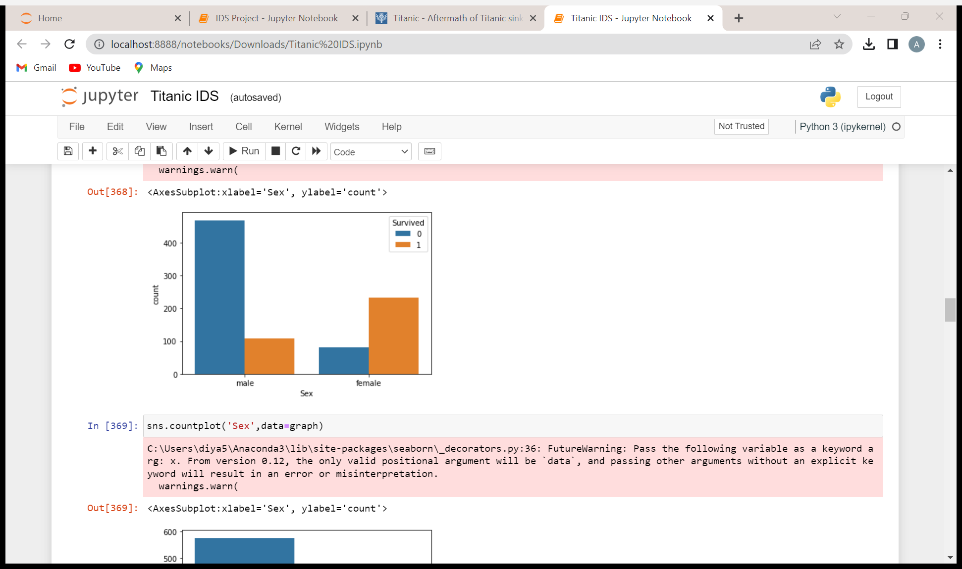
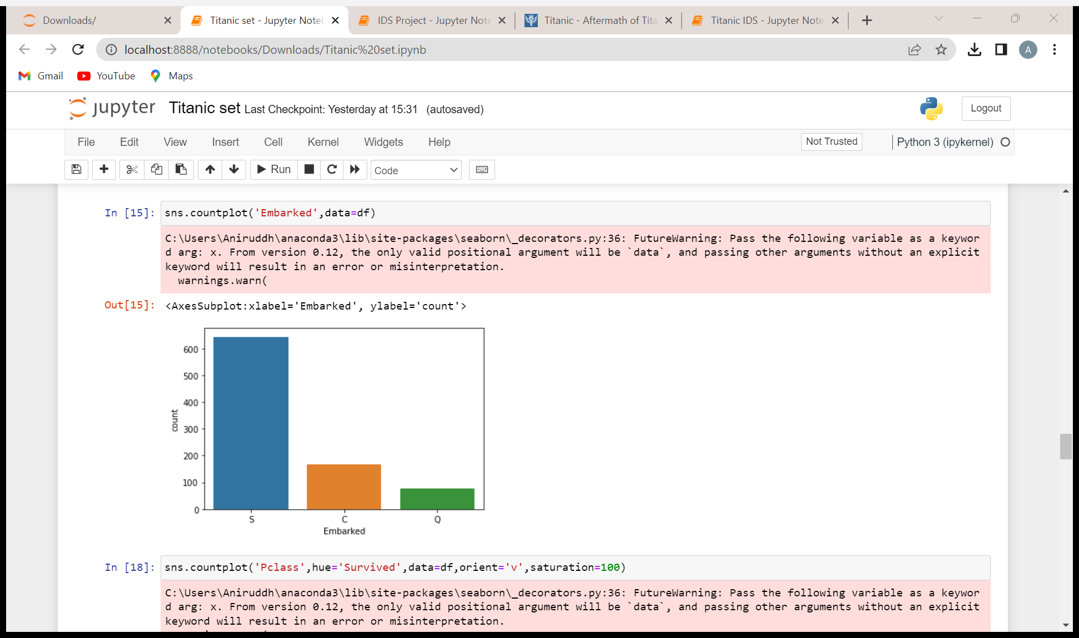
Exploratory Data Analysis
644
168
77
This is the value count of the ‘Embarked’ column from the titanic dataset.
S: Southampton
Q: Queenstown
C: Cherbourg
This is the graph for the people who survived and who didn’t based on their ‘Sex’, which has been taken from the titanic dataset.

Slide 10
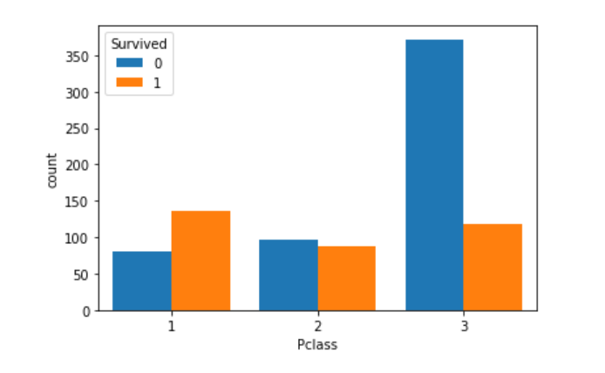
Exploratory Data Analysis
This is the people who survived and who didn’t based on their Pclass. The data has been taken from the titanic dataset.

Slide 11
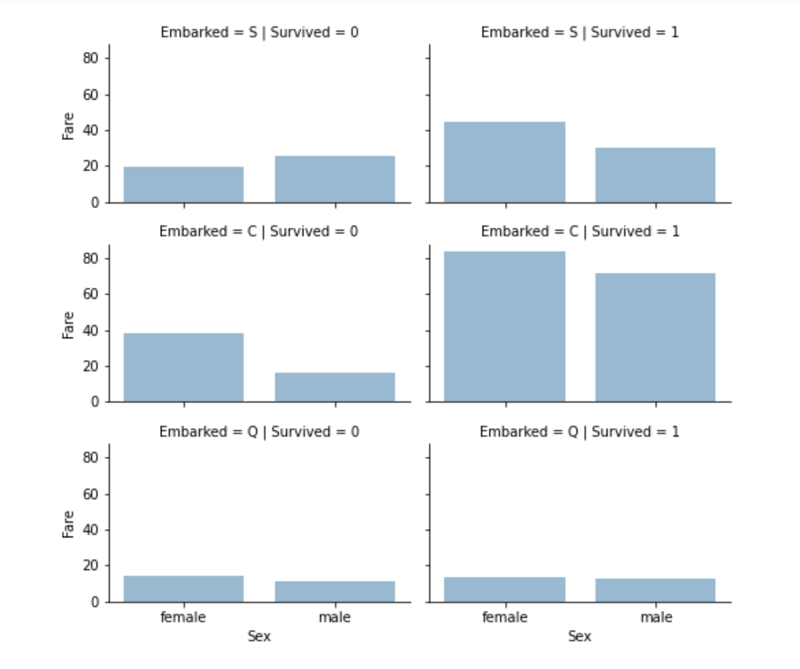
Exploratory Data Analysis
These are graphs according to the ‘Embarked’ column segregated as per the people who survived and who didn’t, based on their gender.
The data has been taken from the titanic dataset.

Slide 12
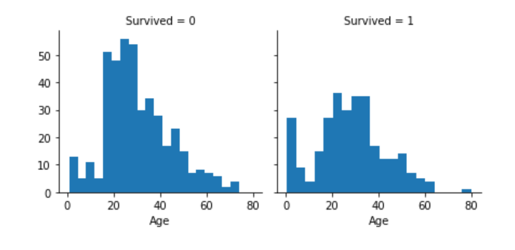
Exploratory Data Analysis
The data has been segregated as per the people who survived and who didn’t, based on their age. The data has been taken from titanic dataset.

Slide 13
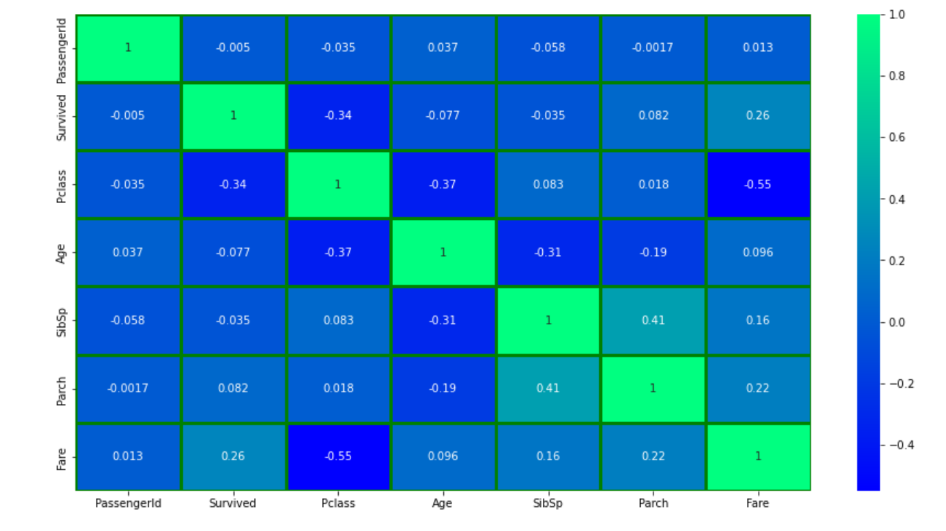
Heatmap
Data visualization of titanic dataset that displays aggregated information in a visually appealing way.

Slide 14
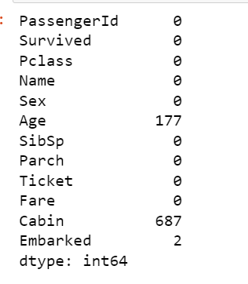
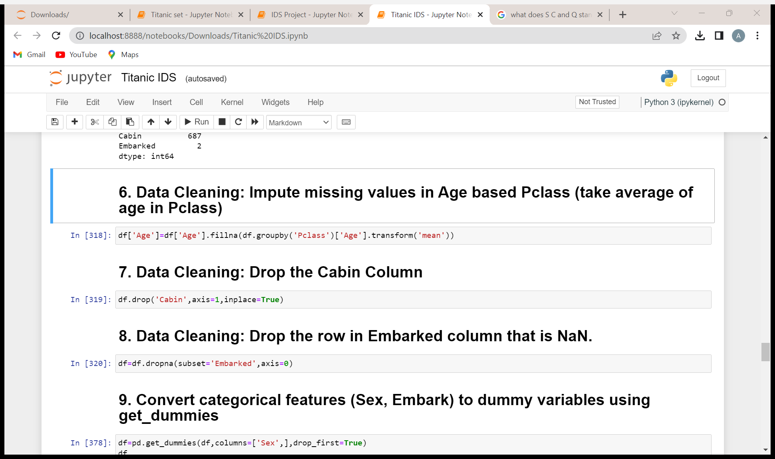
Checking for missing data and Data Cleaning
Checking for missing data.
Treating the missing data.

Slide 15
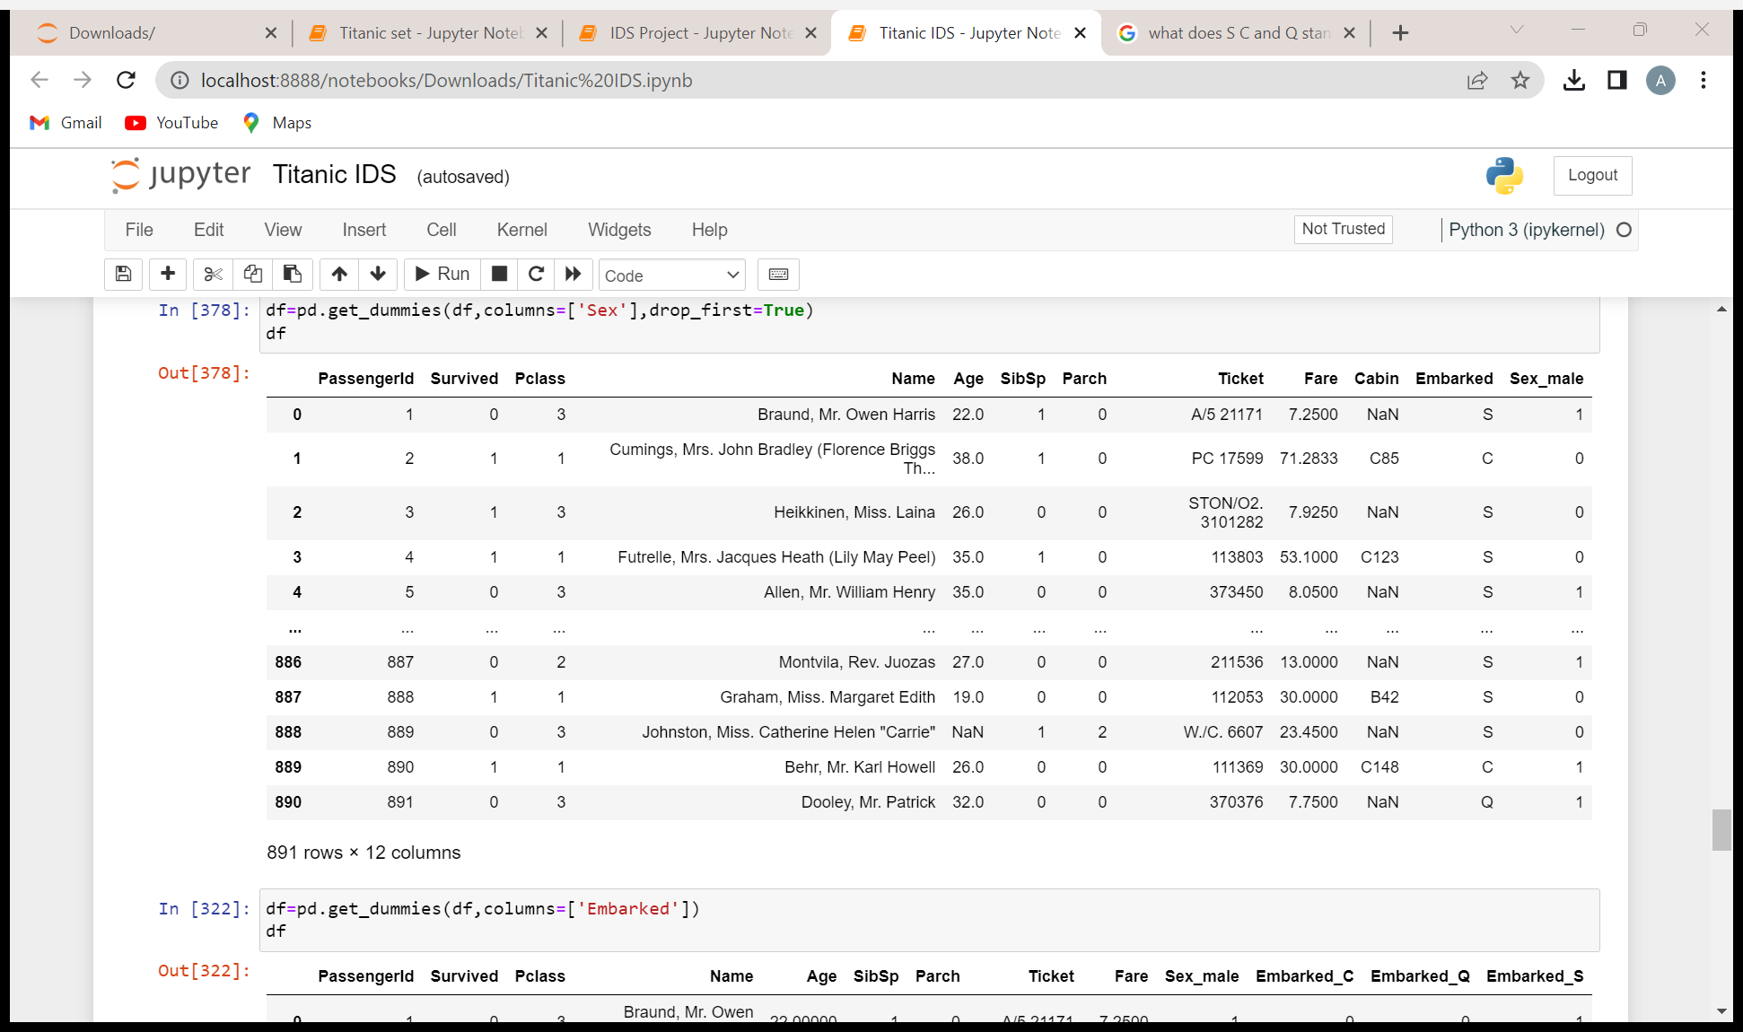
Getting Dummy Values for ‘Sex’ Column
We use the ‘get_dummies’ function to convert the ordinal data to numerical data.
0: Female
1: Male

Slide 16
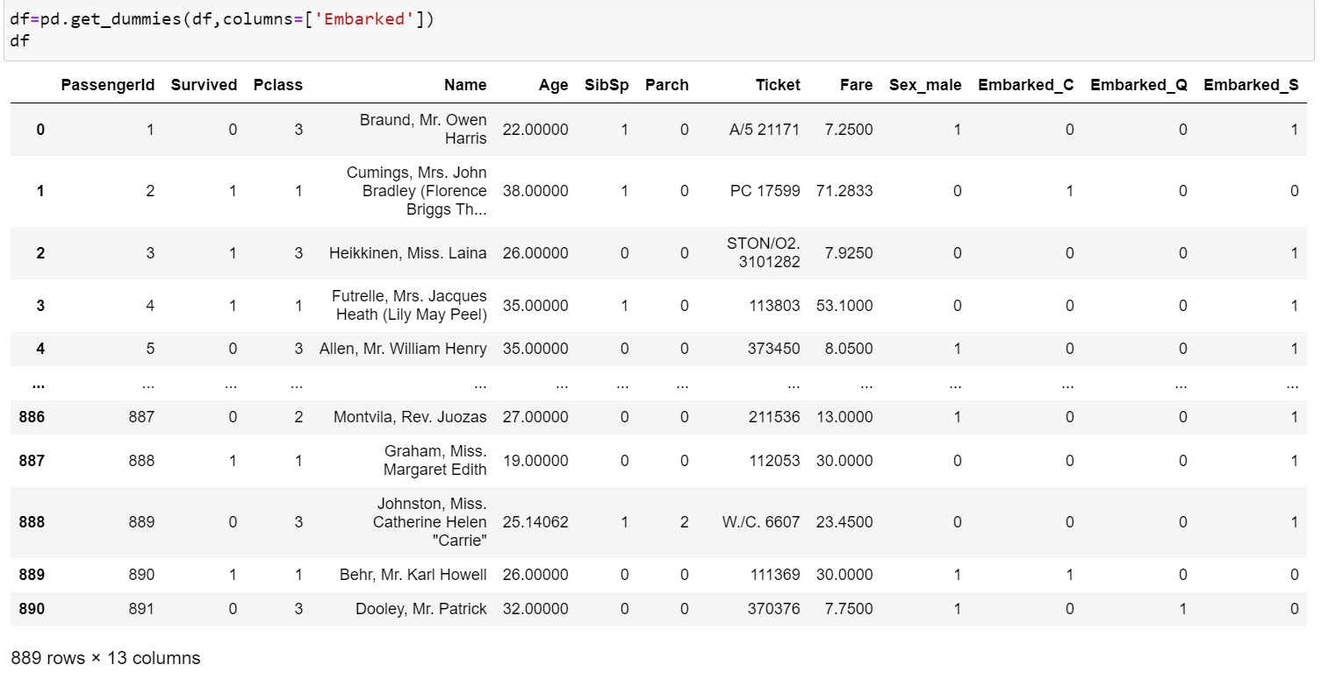
Getting Dummy values for ‘Embarked’ Column
We again use ‘get_dummies’ function to convert the ordinal data in ‘Embarked’ column to numerical data. Since the types of values in ‘Embarked’ column is more than 2, it creates 3 separate columns. ‘1’ in any column defines that it belongs to that column and ‘0’ means otherwise.

Slide 17
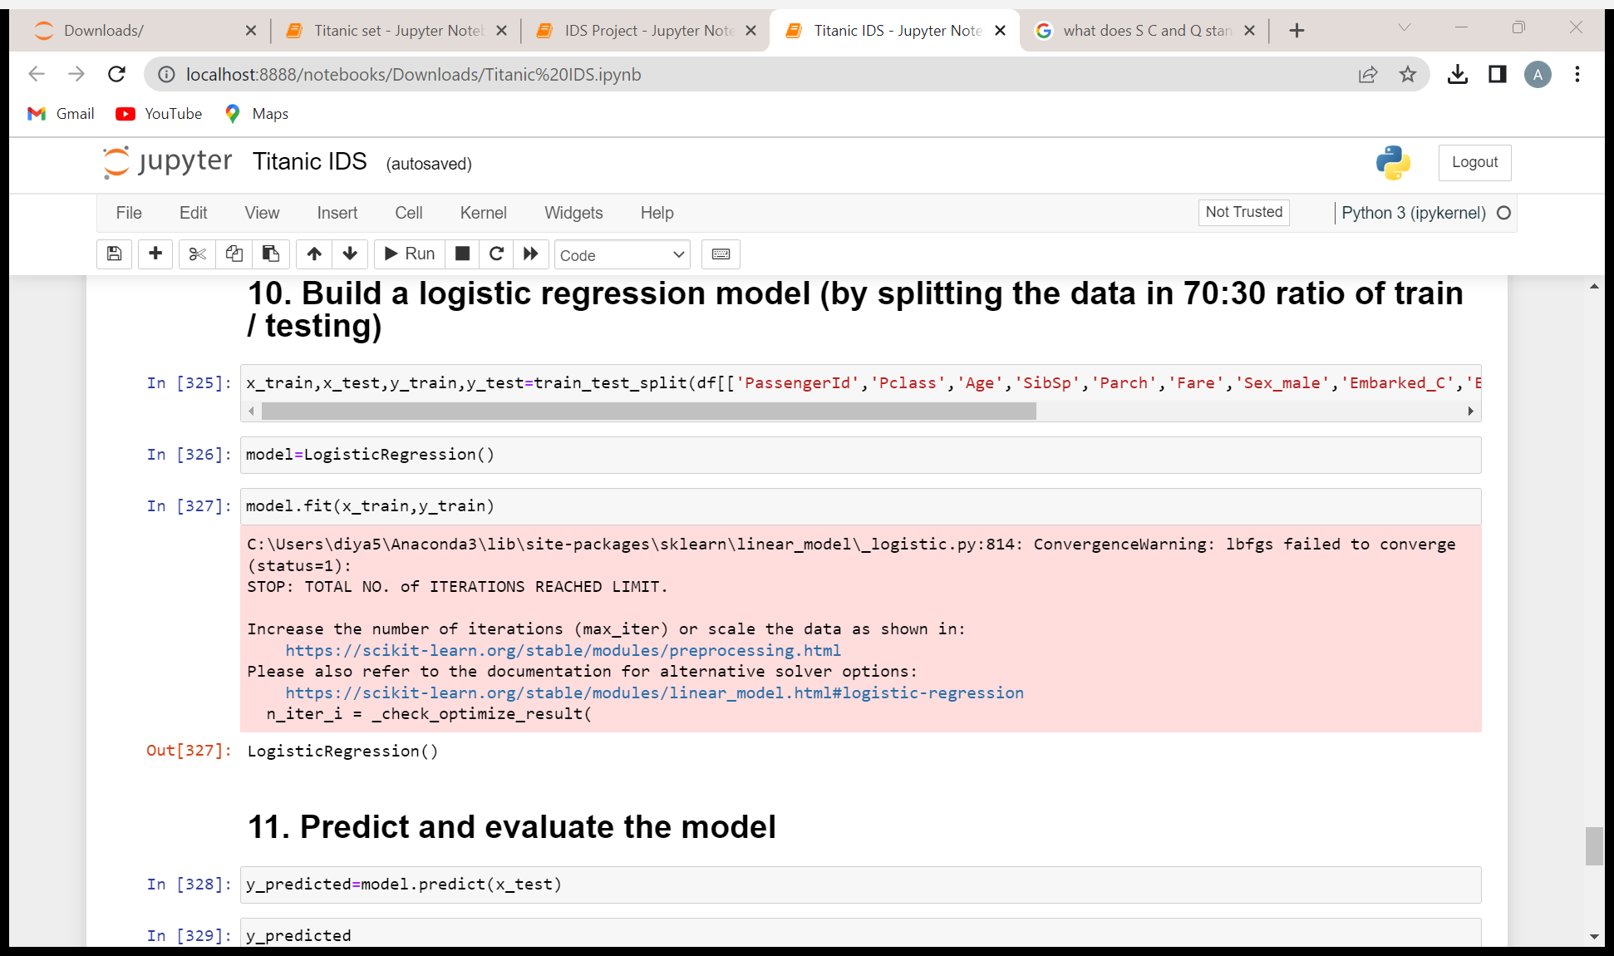
Building the model
We now start building our model by splitting the dataset in 70:30 ratio in training and testing data. Then we try to fit our model.

Slide 18
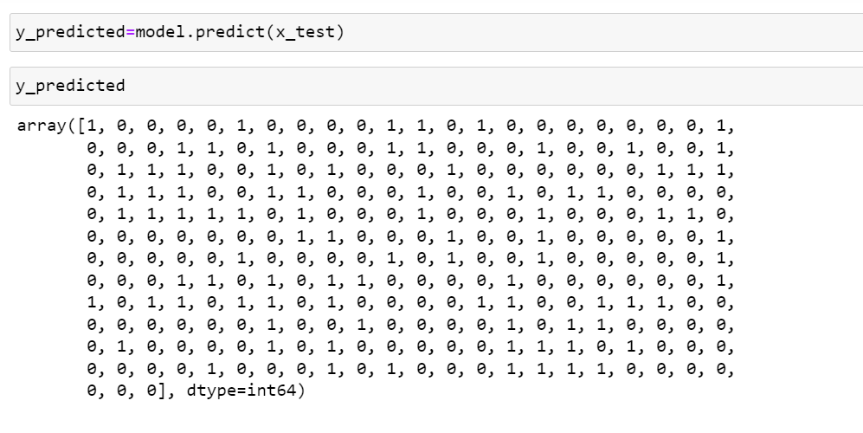
Predicting the values

Slide 19
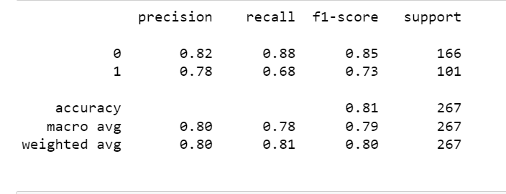
Classification Report

Slide 20

Accuracy
81%

Slide 21
Thanks!
.A Project By:
Diya Patel

Slide 22
References
Kaggle Titanic Dataset Solutions
https://youtu.be/Lgp14y9-U74
‘Titanic’ by Rupert Matthews
https://www.britannica.com/topic/Titanic
https://www.history.com/topics/early-20th-century-us/titanic

